Slide 1
Economic Indicators Data Analytics Project
Global Income Inequality, Human Development Index, and the Gini Coefficient
By Kerrigan de Meij

Slide 2
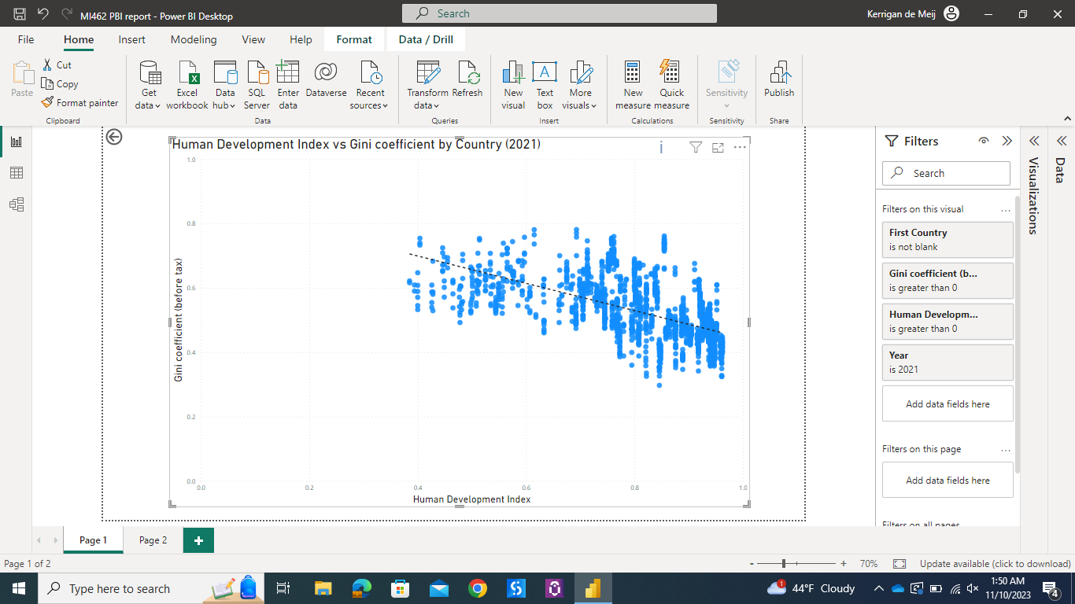
Relationship Between the Human Development Index and Gini Coefficient
HDI is on the x-axis as the independent variable, and the Gini-Coefficient as the dependent variable on the y-axis. This slightly negative relationship shown by the downward slope means that as the HDI increases, the Gini-Coefficient is somewhat likely to decrease (reverse is also true).
When examining this relationship, this is the result to be logically assumed, because one could reason that as a nation improves its HDI aspects such as health, education, etc. then its overall income inequality between income classes would decrease as measured by the Gini Coefficient (value of 0 =perfectly equal, 1=perfectly unequal).

Slide 3
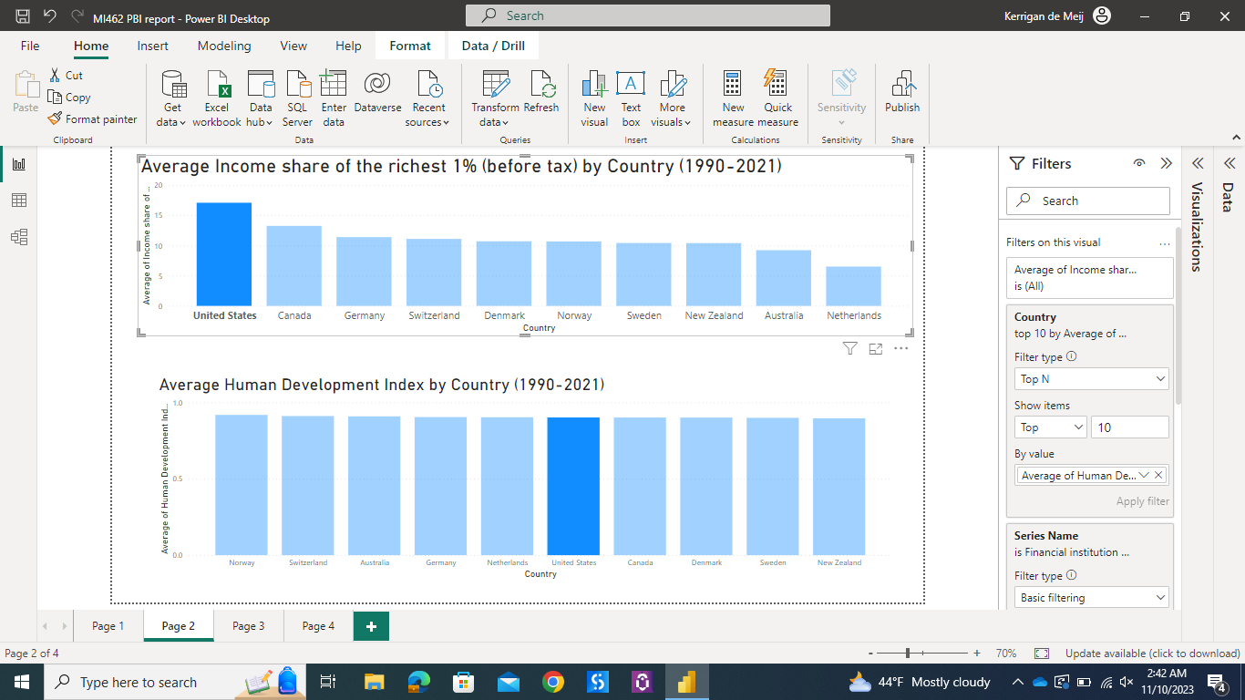
The Richer the Better?
Income Distribution can be displayed by the measure of Income Shares across different percentages of people.
The U.S. has the highest average income share of the richest 1%, however countries like Norway, Australia, and the Netherlands have a higher average HDI level.
-A high amount of people in the top 1% of income distribution may not contribute to a well-rounded society
-As shown by these results it may even have the opposite effect. Countries with a lower level of the richest 1% may have more evenly distributed income across society and thus may have a higher HDI.

Slide 4
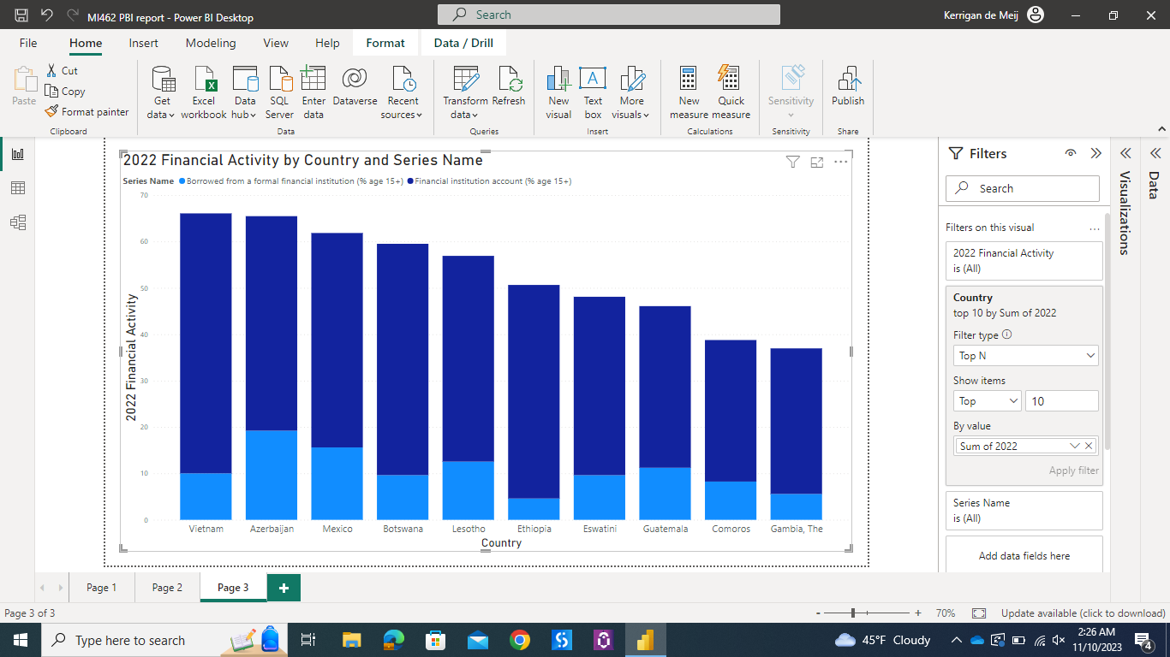
Accounts & Borrowing at Financial Institutions – Global Data from 2022
The countries with the top 10 highest financially active indicators sheds some light on the question: how applicable can a dataset be?. These numbers may not be realistic or accurate due to exchange rates/currency values being different internationally, or whether the financial account usage belongs to accounts overseas or of domestic citizens.
This visual shows surprising countries such as Vietnam and Ethiopia having high financial account and loan activity. Is this a dataset-quality issue, or could it be possible that a high number of off-shore accounts receive deposits in these countries for various business reasons?

Slide 5
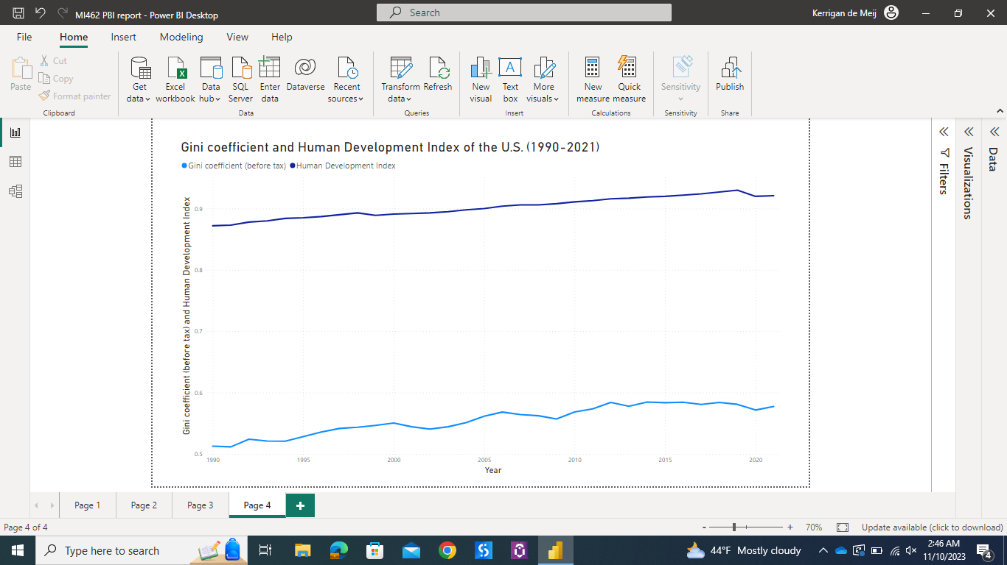
The United States’ Gini-Coefficient and HDI from 1990 to 2021
Previous slides displayed the HDI and Income Share of the US - but what does its Income Inequality measure look like over time?
This line graph shows that the United States’ Gini Coefficient has been slowly increasing since the 1990s, which means that income inequality is worsening over time.

Slide 6
Conclusion about the Data
The Gini-Coefficient and Human Development Index data can be paired together to form insights and relationships about Income Inequality regarding the overall quality of the society on a global level (to the extent of these datasets years and data collected).
The “borrowing trends” dataset provided percentages of respondents who reported having an account at a Financial Institution, and who have reported borrowing from a Financial Institution (Ages 15+) was less useful/applicable in this scenario because of the need for more detail in the data
Dataset could have specified if the financial accounts belonged to domestic citizens or overseas contributors
Did not specific any method of standardizing the currencies using foreign exchange rates and value/purchasing power of different currencies.

